Slide 1

First Title & Escrow, Inc.
2010 New Features
We are pleased to announce that our system has been updated to reflect the new 2010 HUD and GFE changes!! In accordance with these new RESPA regulations, we have introduced the following new features:
New Closing Cost Calculator
Instant 2010 RESPA compliant GFE
Instant 2010 RESPA compliant HUD-1
www.firsttitleservices.com
1-866-4TITLES (484-8537)
Presented By: Stephen J. Papermaster

Slide 2

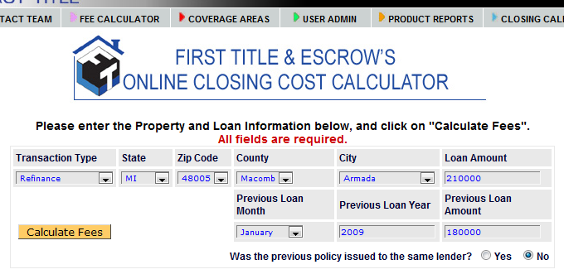
New Closing Cost Calculator
Choose from the available options and click “Calculate Fees”

Slide 3
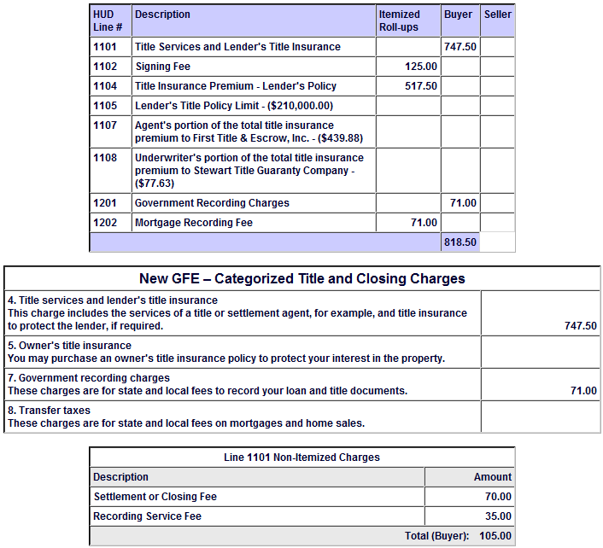
Anatomy of First Title’s Fee Calculation System
As you know, our Web-Based System has been providing our customers with EXACT Title, Closing, Recordation and Transfer charges in order to prepare their GFE’s in the past. To assist you in further preparation of the new form GFE, we now display the charges in three different formats:
1. HUD-1 Line Number
2. GFE Block Number
3. Line 1101 Non-Itemized Charges

Slide 4
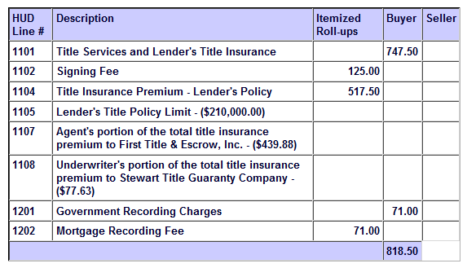
HUD Line Number
As displayed on the new 2010 HUD-1
Not only have the line numbers changed on the new HUD-1, but there is a new column titled
"Itemized Roll-ups."
Fees are displayed by Line number!
What does "Itemized Roll-ups" mean? The new rules require that certain charges subtotal into other charges on the HUD-1 so they can be represented as one single fee. The following lines will all total and carry into another line displayed as a package to the buyer/borrower for your disclosures:
Title and Settlement charges in lines 1102 and 1104 will roll into 1101 with other itemized charges as displayed in the line 1101 itemization.
Clerk Recording charges listed in line 1202 will roll into line 1201.
Transfer and Mortgage stamps listed in lines 1204-1206 will roll into 1203.

Slide 5
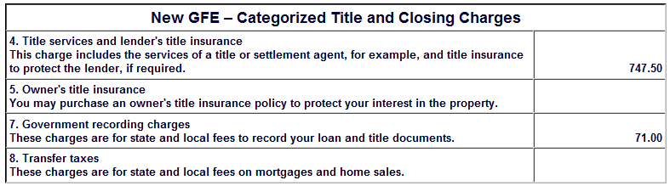
GFE Block Number
Take our numbers and input them directly into your GFE!

Slide 6
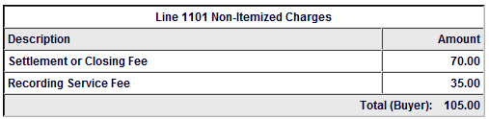
3. Line 1101 Non-Itemized Charges
Line 1101 has been itemized to break down the various charge that are included in the new 1101 bundle displayed on the new HUD.

Slide 7

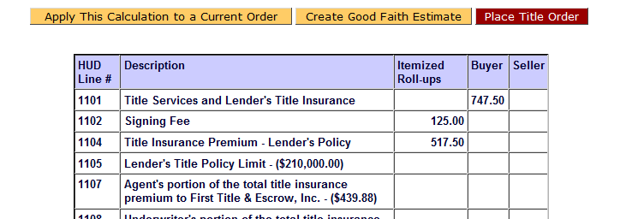
Instant GFE
Click directly from your fee calculation!
www.firsttitleservices.com
1-866-4TITLES (484-8537)

Slide 8
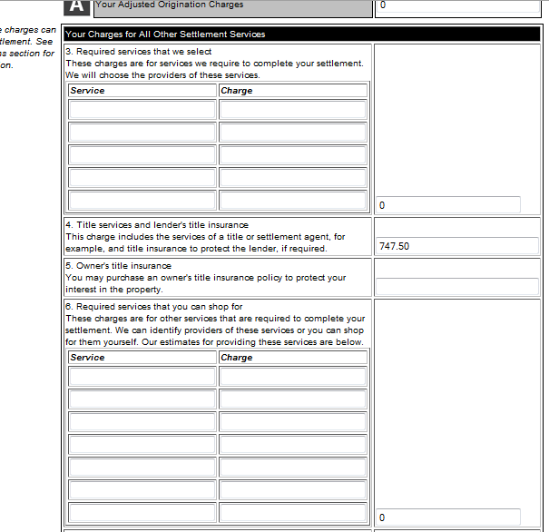
Fully Editable GFE
The fully editable GFE form pulls in the data from your fee calculation and automatically sums your entries.
Instantly view, download and email your completed GFE.

Slide 9
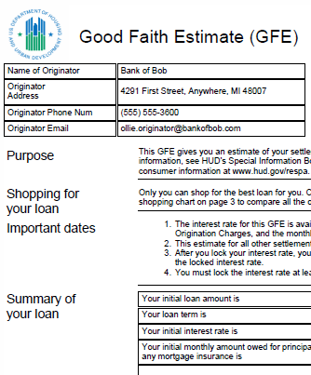
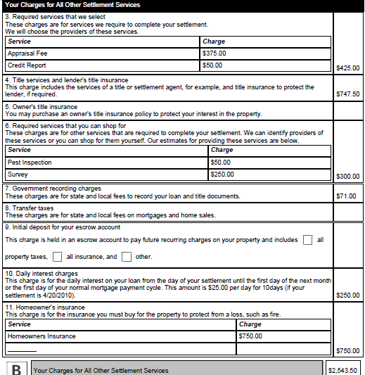
Completed GFE

Slide 10
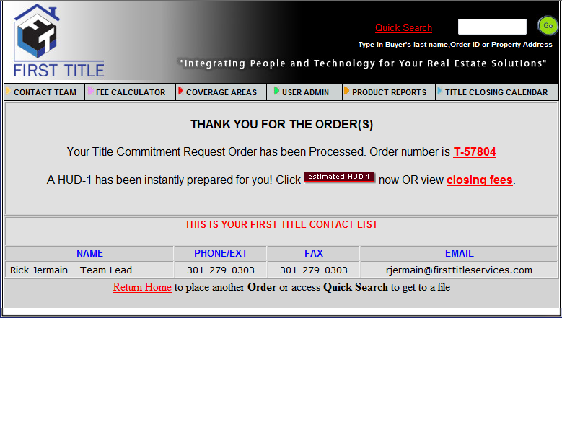
Instant HUD-1
The “Estimated HUD-1” button to view your instant HUD-1 is available the second you place your order!
www.firsttitleservices.com
1-866-4TITLES (484-8537)

Slide 11
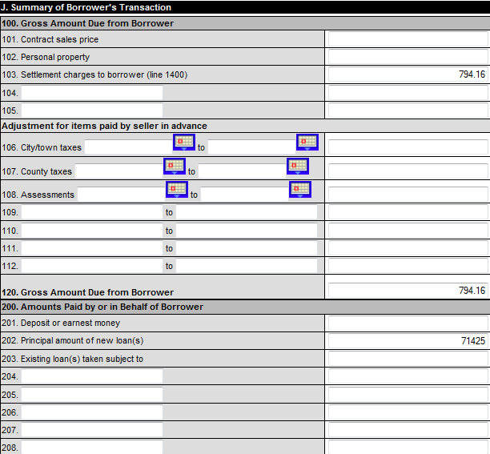
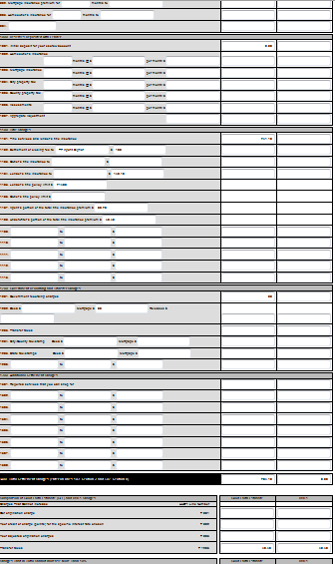
Fully Editable HUD-1
The fully editable HUD-1 form pulls in the data from your First Title order and automatically sums your entries.
Instantly view, download and email your completed HUD-1.

Slide 12
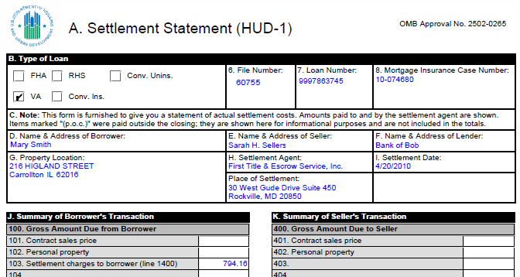
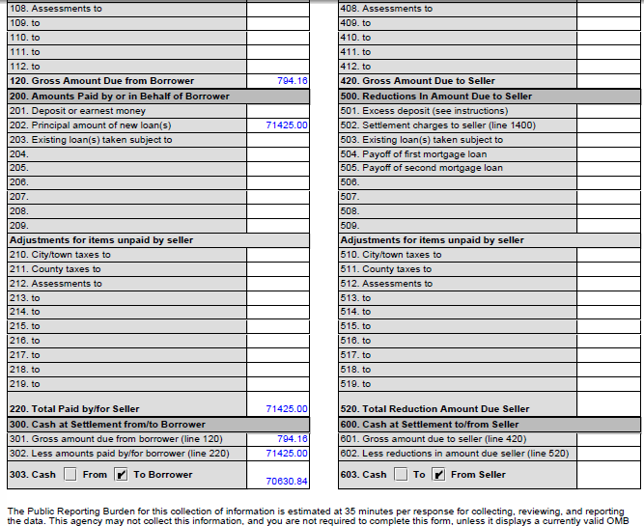
Completed 2010 HUD-1

Slide 13
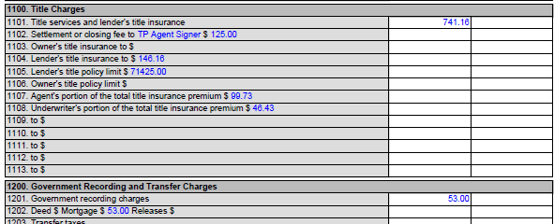
Bundled Fees in the 1100 Series
All closing related title insurance and recording fees calculated in seconds!

Slide 14
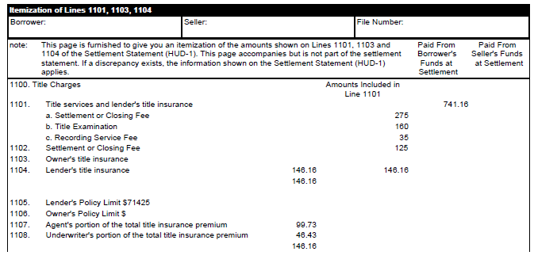
HUD-1 Itemization Page
A separate itemization of line 1101 fees listed on Page 4 of the new HUD for your review.

Slide 15

Presented By
Stephen J. Papermaster, President
First Title & Escrow Inc
30 West Gude Drive, 4th Floor
Rockville, MD 20850
Direct Dial 301-315-8180
Personal Fax 301-315-8181
Email: spape@FirstTitleServices.com
www.firsttitleservices.com
1-866-4TITLES (484-8537)

